Slide 1
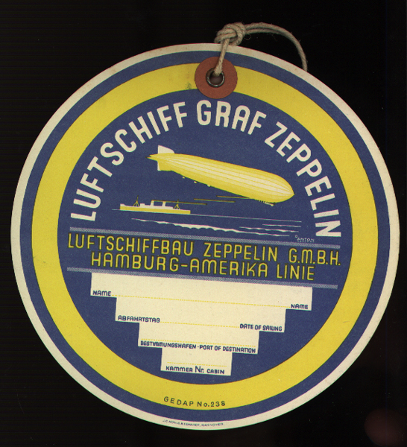
Baggage label, Luftschiff Graf Zeppelin, ca. 1930
Illustrated by Ottomar Anton, 1895-1976, German
Printed by J.C. König & Ebhardt, Hannover, Germany
The Wolfsonian-FIU, The Mitchell Wolfson Jr. Collection
XB1992.1229

Slide 2
Postcard, Ferdinand Adolf Heinrich August Graf von Zeppelin (1838-1917), [1928?]
Published by A. Weber & Co., Stuttgart, Germany
Photographed by Luftschiffbau Zeppelin
The Wolfsonian-FIU, The Mitchell Wolfson Jr. Collection
XC1994.4317.1
After resigning from the army in 1891 at age 52, Graf von Zeppelin devoted his full attention to airships. On 2 July 1900, he made the first flight with the LZ1 over Lake Constance near Friedrichshafen in southern Germany.

Slide 3
Postcard, Airship works, Friedrichshafen. View from the West, [1928?]
Published by A. Weber & Co., Stuttgart, Germany
Photographed by Luftschiffbau Zeppelin
The Wolfsonian-FIU, The Mitchell Wolfson Jr. Collection
XC1994.4317.3

Slide 4
Postcard, Christening of the Graf Zeppelin, [1928?]
Published by A. Weber & Co., Stuttgart, Germany
Photographed by Luftschiffbau Zeppelin
The Wolfsonian-FIU, The Mitchell Wolfson Jr. Collection
XC1994.4317.2
LZ 127 was christened "Graf Zeppelin" by Countess Brandenstein-Zeppelin in July 1928, the 90th anniversary of the birth of her father, Ferdinand von Zeppelin (1838-1917).

Slide 5
Schedule, Use the German Air Mail Service to South America, 1934
Published by Wm. H. Müller & Co., London, 1934
The Wolfsonian-FIU, The Mitchell Wolfson Jr. Collection
XB1992.1918
In 1932 the Graf began five years of providing regularly scheduled passenger, mail, and freight service between Germany and South America (Brazil).

Slide 6
Postcard, Passengers boarding the Graf Zeppelin, [1928?]
Published by Gebr. Metz, Kunstanstallt, Tübingen, Germany
Photographed by Abt. Luftschiffbau Zeppelin
The Wolfsonian-FIU, The Mitchell Wolfson Jr. Collection
XB1992.182
During its nine years of service, the Graf Zeppelin flew more than 1,056,000 miles, thus becoming the first aircraft in history to fly over a million miles. It made 590 flights, 144 oceanic crossings (143 across the Atlantic, one across the Pacific), carried a total of 13,110 passengers, and spent 17,177 hours aloft (the equivalent of 717 days, nearly two years). No passenger nor crewman was ever injured during the course of any of these flights.

Slide 7
Postcard, Passenger lounge and dining room, on board the Graf Zeppelin, [1928?]
Published by Gebr. Metz, Kunstanstallt, Tübingen, Germany
Photographed by Abt. Luftschiffbau Zeppelin
The Wolfsonian-FIU, The Mitchell Wolfson Jr. Collection
XB1992.184
This combination lounge/dining room was the only public space aboard the airship. Since it had no heating system, the luxury of this room could not compensate for the low temperatures experiences during winter or while crossing the North Atlantic. Passengers often spent much of their time wrapped in heavy winter coats or covered by layers of blankets while ice crystals formed on the windows.

Slide 8
Postcard, One of Graf Zeppelin's two port engine gondolas, [1928?]
Published by Gebr. Metz, Kunstanstallt, Tübingen, Germany
Photograph by Abt. Luftschiffbau Zeppelin
The Wolfsonian-FIU, The Mitchell Wolfson Jr. Collection
XB1992.204
Graf Zeppelin was powered by five Maybach VL-2 12-cylinder engines, which could achieve 550 hp at maximum RPM, and 450 hp at 1,400 RPM for cruising speed.

Slide 9
Postcard, Graf Zeppelin: Steering room, [1928?]
Published by A. Weber & Co., Stuttgart, Germany
Photographed by Luftschiffbau Zeppelin
The Wolfsonian-FIU, The Mitchell Wolfson Jr. Collection
XC1994.4317.5

Slide 10
Postcard, Graf Zeppelin: Radio room, [1928?]
Published by A. Weber & Co., Stuttgart, Germany
Photographed by Luftschiffbau Zeppelin
The Wolfsonian-FIU, The Mitchell Wolfson Jr. Collection
XC1994.4317.6
A staff of three radio operators communicated with ground stations and ships, performed radio navigation, received weather reports, and sent private telegrams for passengers. During the airship's transatlantic flight to the United States in October 1928, the radio room sent 484 private telegrams and 160 press telegrams.

Slide 11
Postcard, Graf Zeppelin: The galley, [1928?]
Published by A. Weber & Co., Stuttgart, Germany
Photograph by Luftschiffbau Zeppelin
The Wolfsonian-FIU, The Mitchell Wolfson Jr. Collection
XC1994.4317.7
The galley was equipped with a single electric oven with two compartments and hot plates on top for cooking, as well as a water heater for coffee and tea.

Slide 12
Menu, Third Day Supper, first Europe Pan-American flight, [1928?]
Inside spread of menu mounted on white board, with tipped in illustration depicting The Graf Zeppelin over New York: the Sherry-Netherland Hotel
The Wolfsonian-FIU, The Mitchell Wolfson Jr. Collection
XB2013.05.6
Supper prepared by Louis Sherry, New York

Slide 13
Postcard, Graf Zeppelin: Passenger lounge and dining room, [1928?]
Published by A. Weber & Co., Stuttgart, Germany
Photographed by Luftschiffbau Zeppelin
The Wolfsonian-FIU, The Mitchell Wolfson Jr. Collection
XC1994.4317.8

Slide 14
Postcard, Graf Zeppelin: Passenger cabin set for the day, [1928?]
Published by A. Weber & Co., Stuttgart, Germany
Photographed by Luftschiffbau Zeppelin
The Wolfsonian-FIU, The Mitchell Wolfson Jr. Collection
XC1994.4317.9

Slide 15
Postcard, Graf Zeppelin: Passenger cabin set for the night, [1928?]
Published by A. Weber & Co., Stuttgart, Germany
Photographed by Luftschiffbau Zeppelin
The Wolfsonian-FIU, The Mitchell Wolfson Jr. Collection
XC1994.4317.10

Slide 16
Label, Im Zeppelin über den Ozean [Over the ocean by Zeppelin, [1935?]
Printed by Muhlmeister & Johler, Hamburg, Germany
Illustrated by Ottomar Anton (1895-1976), German
The Wolfsonian-FIU, The Mitchell Wolfson Jr. Collection
XC1994.3152
Deutsche Zeppelin-Reederei [German Zeppelin Transportation Company] was created in 1935 to operate commercial passenger airship flights. On 19 March 1936 the airship LZ Hindenburg was licensed to carry passengers and handed over to the DZR, permitting the airline to maintain regular South and North American routes.

Slide 17
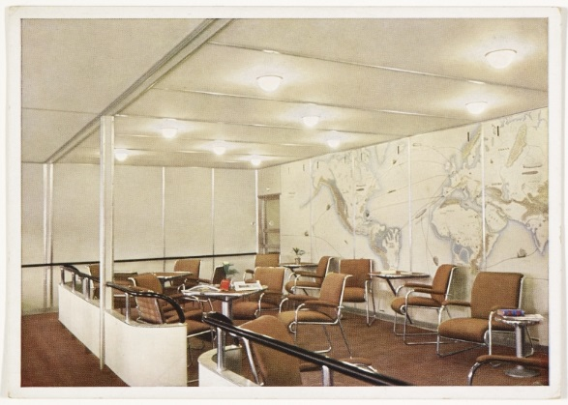
Postcard, Passenger lounge on board the Hindenburg, 1938
Published by Verlag Gebr. Metz, Tübingen, Germany
Photographed by O. v. Stetten
The Wolfsonian-FIU, The Mitchell Wolfson Jr. Collection
XC1992.441.1
The furniture was designed by Fritz August Breuhaus (1883-1960) using lightweight tubular aluminum.

Slide 18
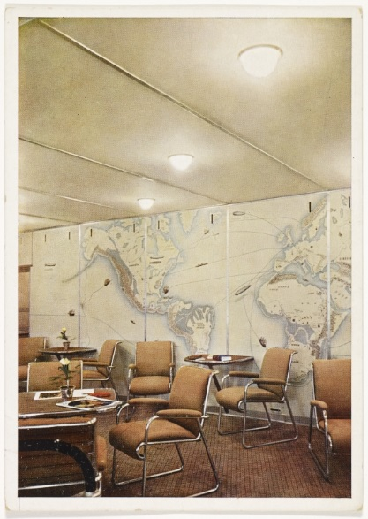
Postcard, Passenger lounge on board the Hindenburg, 1938
Published by Verlag Gebr. Metz, Tübingen, Germany
Photographed by O. v. Stetten
The Wolfsonian-FIU, The Mitchell Wolfson Jr. Collection
XC1992.441.2
The mural, designed by Otto Arpke (1886-1943) , shows the routes and ships of the explorers Ferdinand Magellan, James Cook, Vasco da Gama, and Christopher Columbus, the transatlantic crossing of LZ-126 (USS Los Angeles), the round-the-world flight and South American crossings of LZ-127 Graf Zeppelin, and the North Atlantic tracks of the great German ocean liners Bremen and Europa.

Slide 19
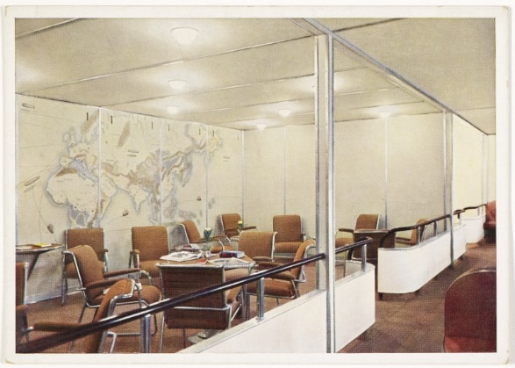
Postcard, Passenger lounge on board the Hindenburg, 1938
Published by Verlag Gebr. Metz, Tübingen, Germany
Photographed by O. v. Stetten
The Wolfsonian-FIU, The Mitchell Wolfson Jr. Collection
XC1992.441.3

Slide 20
Postcard, Dining room on board the Hindenburg, 1938
Published by Verlag Gebr. Metz, Tübingen, Germany
Photographed by O. v.Stetten
The Wolfsonian-FIU, The Mitchell Wolfson Jr. Collection
XC1992.441.4

Slide 21
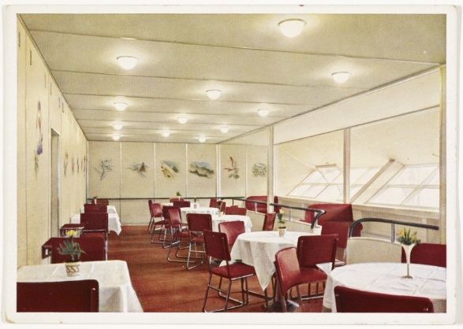
Postcard, Dining room on board the Hindenburg, 1938
Published by Verlag Gebr. Metz, Tübingen, Germany
Photographed by O. v. Stetten
The Wolfsonian-FIU, The Mitchell Wolfson Jr. Collection
XC1992.441.5
The dining room occupied the entire length of the port side of A Deck. It measured approximately 47 feet in length by 13 feet in width.

Slide 22
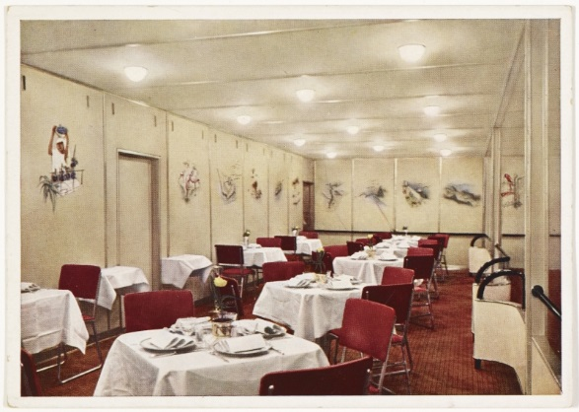
Postcard, Dining room on board the Hindenburg, 1938
Published by Verlag Gebr. Metz, Tübingen, Germany
Photograph by O. v. Stetten
The Wolfsonian-FIU, The Mitchell Wolfson Jr. Collection
XC1992.441.6
The walls were decorated with paintings on silk wallpaper by Otto Arpke (1886-1943), depicting scenes from Graf Zeppelin’s flights to South America.

Slide 23
Postcard, Reading and writing room on board the Hindenburg, 1938
Published by Verlag Gebr. Metz, Tübingen, Germany
Photographed by O. v. Stetten
The Wolfsonian-FIU, The Mitchell Wolfson Jr. Collection
XC1992.441.7
The walls of this room were decorated with paintings by Otto Arpke (1886-1943) presenting scenes from around the world.

Slide 24
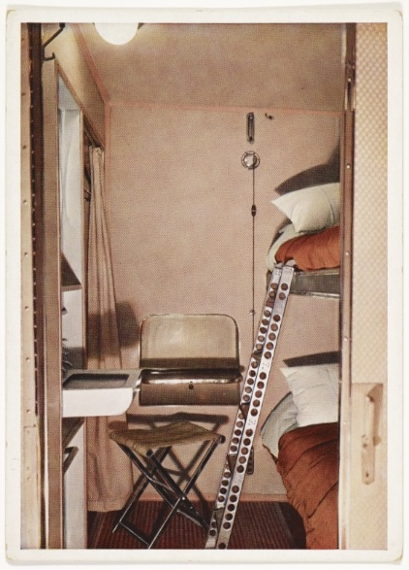
Postcard, View of double-berthed cabin on board the Hindenburg, 1938
Published by Verlag Gebr. Metz, Tübingen, Germany
Photograph by O. v. Stetten
The Wolfsonian-FIU, The Mitchell Wolfson Jr. Collection
XC1992.441.8
Each cabin, comparable to railroad sleeper compartments of the era, were equipped with call buttons to summon a steward or stewardess, a small fold-down desk, a wash basin made of lightweight white plastic with taps for hot and cold water, and a small closet covered with a curtain in which a limited number of suits or dresses could be hung. Other clothes and luggage had to be kept in their suitcases, which could be stowed under the lower berth.

Slide 25
Postcard, Smoking room on board the Hindenburg, 1938
Published by Verlag Gebr. Metz, Tübingen, Germany
Photographed by O. v. Stetten
The Wolfsonian-FIU, The Mitchell Wolfson Jr. Collection
XC1992.441.9
The smoking room was painted blue, with dark blue-grey leather furniture, and the walls were decorated with yellow pigskin and illustrations by Otto Arpke (1886-1943) depicting the history of lighter-than-air flight from the Montgolfiers’s balloon to the Graf Zeppelin.

Slide 26
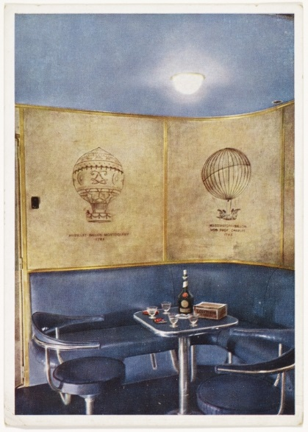
Postcard, Smoking room on board the Hindenburg, 1938
Published by Verlag Gebr. Metz, Tübingen, Germany
Photograph by O. v. Stetten
The Wolfsonian-FIU, The Mitchell Wolfson Jr. Collection
XC1992.441.8
The smoking room was kept at higher than ambient pressure, so that no leaking hydrogen could enter the room. This room (and its associated bar) were also separated from the rest of the ship by a double-door airlock. One electric lighter was provided, as no open flames were allowed aboard the ship.

